Slide 1
Spring Cloud Config

Slide 2











What is Spring cloud config
Spring cloud config server is an online service where all configurable parameters of other microservices are maintained to be referred by other microservices.
Spring Cloud Config provides server and client-side support for externalized configuration in a distributed system. With the Config Server you have a central place to manage external properties for applications across all environments.
Spring Cloud Config Server features:
HTTP, resource-based API for external configuration (name-value pairs, or equivalent YAML content)
Encrypt and decrypt property values (symmetric or asymmetric)
Embeddable easily in a Spring Boot application using @EnableConfigServer

Slide 3
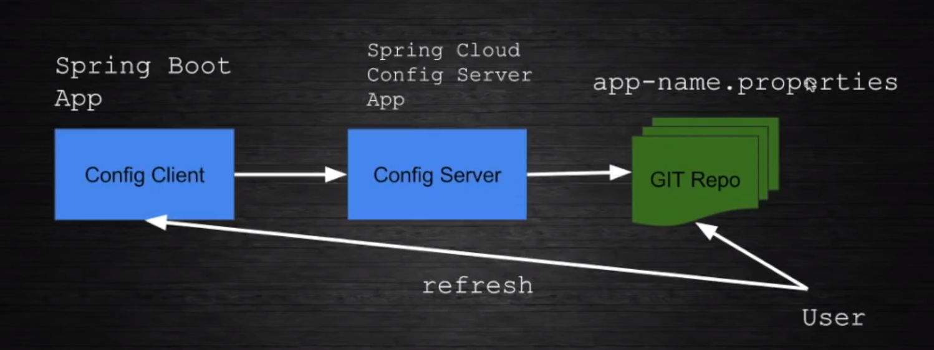







Slide 4
Dependencies required
Spring-config server – Mandatory
……
@EnableConfigServer
@SpringBootApplication
public class SpringCloudConfigApplication {
public static void main(String[] args) {
SpringApplication.run(SpringCloudConfigApplication.class, args);
}
}

Slide 5
Bootstrap.properties - Sample
spring.cloud.config.server.git.uri=file:///E:/spring_boot_new_projects/spring_cloud_config
Git Uri location

Slide 6
Spring config client
Dependencies
Config-client
Actuator
Web

Slide 7
Client an access the updated properties WO restarting the application
Bootstrap.properties
spring.application.name=config-client
spring.cloud.config.uri=http://localhost:8081
spring.config.import=optional:configserver:http://localhost:8087
@RefreshScope
@Configuration
@RestController
public class TestController {
@Value("${message:Hello}")
private String message;
@GetMapping("/receive")
public String test()
{
return "message received:"+message;
}
}
Name of the file where the properties are stored and read by Config server with ext .properties
Prints the default message Hello if not read from server
management.endpoints.web.exposure.include=*
Add this in application.properties to expose the refresh option

Slide 8
GIT commands
Git init – initializes the repository
Git add <filename> --should match with the client application name
Git commit –m <filename> - commits the file.

Slide 9
Encryption and Decryption
http://www.appsdeveloperblog.com/spring-cloud-config-symmetric-encryption-and-decryption/#targetText=For%20Spring%20Cloud%20Config%20to,upper%20and%20lower%20case%20characters.

Slide 10
Uri to refresh the client
<Client app Uri>/actuator/refresh in POST method.
Eg: http://localhost:8085/actuator/refresh

